Slide 1
The "Invisible" Wireless Channel into Our Voting Precincts
Charles Bernardin
(@Guy_Smith on Telegram) and
Sophie Anderson
July 13, 2023
Video Link: https://rumble.com/v30q2ju-the-invisible-wireless-channel-into-our-voting-precincts.html

Slide 2
The 5G US Invasion Strategy
Communism is all about layering accountability so thinly that no one can be held accountable.
FirstNet compatible equipment enables an LTE network that can't be audited or tracked through any FOIA. That's the real purpose. The States’ motives here are obvious and have almost nothing to do with public safety
The Globalists are attempting to steal America by first stealing the US LTE Spectrum. They have already done this in Europe using China as their mercenaries
T-Mobile is the rising 5G star in the USA. They're owned by Deutsche Telekom (i.e. German Government), Vanguard, Blackrock, State Street Capital; just to name a few.

Slide 3
Exploiting the US LTE First Responders Network
AT&T/FirstNet
Sprint-"First Responder"
T-Mobile "Connecting Heroes"
Verizon Frontline
Mutual Aid Agreements among First Responders
-Sharing of resources: This includes sharing of spectrum, towers, and other infrastructure.
-Cross-carrier roaming: This allows first responders to use other companies‘ networks if their own network is overloaded.
Transparency – the 2015 CISA Act protects FirstNet from any Disclosure
-January 2017 Jeh Johnson made Elections Critical Infrastructure:
-On that basis, the Government now argues against any disclosure of LTE Elections Communications for:
  Sprint-"First Responder"
  T-Mobile "Connecting Heroes"
  Verizon Frontline
The primary and COLLECTIVE purpose of these First Responder Networks is Election Fraud, not just Public Safety

Slide 4
Introduction
We will show the Network Architecture of how our Elections are being Stolen by our Government
Though there are many Government Agencies involved, we will focus on the Department of Commerce (DOC) and The FirstNet Authority
We show that the Government has built backdoors into our National Electoral Systems via the Cellular LTE Providers, and most specifically AT&T
1

Slide 5
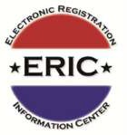




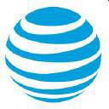
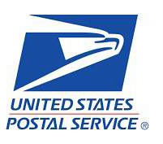

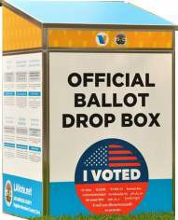

FirstNet®
Authority
AT&T
"–a well-funded cabal of powerful people, ranging across industries and ideologies, working together behind the scenes to influence perceptions, change rules and laws, steer media coverage and control the flow of information. They were not rigging the election; they were fortifying it."
- The Secret History of the Shadow Campaign That Saved the 2020 Election, Molly Ball on the Rigging of the 2020 Election, 2/4/21, Time Magazine https://time.com/5936036/secret-2020-election-campaign/
2

Slide 6

FirstNet®
Authority
The First Responder Network Authority is an independent authority within the U.S. Department of Commerce. Chartered in 2012, its mission is to ensure the building, deployment, and operation of the nationwide broadband network that equips first responders to save lives and protect
U.S. communities.
Lisa Casias
Acting CEO, FirstNet Authority
12201 Sunrise Valley Dr. Reston, VA 20192
Footnote: When 0bama made Election Equipment Critical Infrastructure in January 2017 that made Elections a Public Safety Issue. That also allowed Verizon to realize its existing LTE Network as a First Responder Public Safety Dedicated Network with Priority Access (i.e. Preemption) just like AT&T/FirstNet. They called it Verizon FrontLine. 3/27/18 https://www.verizon.com/about/news/verizon-unveils-public-safety-private-core
See also: https://www.telecompetitor.com/verizon-to-introduce-frontline-first-responder-network/
3

Slide 7
What is FirstNet?
The need for an interoperable public safety network with dedicated spectrum was first recognized in the wake of the 9/11 terrorist attacks, when first responders found it difficult to communicate on the congested cellphone network.
10/28/2012-Congress created the First Responder Network Authority and set aside 20 MHz of spectrum in the 700 MHz frequency band, known as Band 14, to ensure vital communications during a disaster.
This low-band spectrum was chosen because it offers several advantages, including the ability to penetrate walls and other obstacles, helping to ensure excellent coverage.
3/31/2017-FirstNet operates as a public-private collaboration between the First Responder Network Authority and AT&T.
1/25/2018-In the event of an emergency, FirstNet users have priority over non-FirstNet users (Preemption) and, if necessary, all commercial LTE traffic will be dropped and the network will be dedicated exclusively to first responders, as well as to the “Extended Primary” group as bandwidth allows.
During a crisis, a normal cell phone might stop working, but FirstNet-enabled devices
will continue to work.
4
https://www.digi.com/solutions/by-technology/firstnet

Slide 8
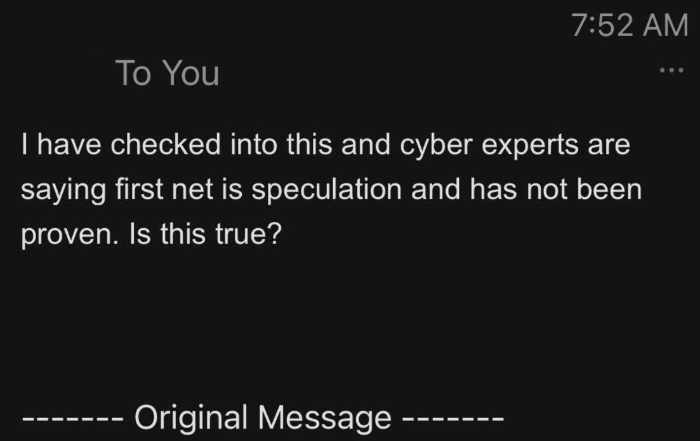
5

Slide 9
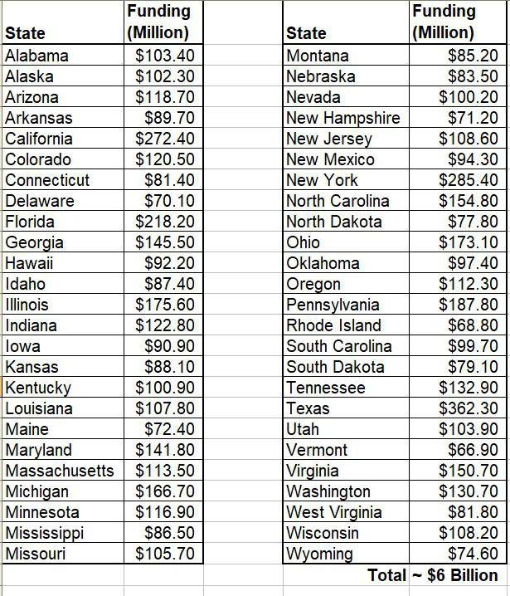
FirstNet Government Funding By State
According to the FirstNet website, the following amounts of government funding have been allocated for the initial build out of FirstNet in each of the 50 states:
The federal government has allocated $7 billion for developing FirstNet, and the states have allocated an additional $2 billion.
The maintenance cost of FirstNet is expected to be around $1 billion per year.
6

Slide 10
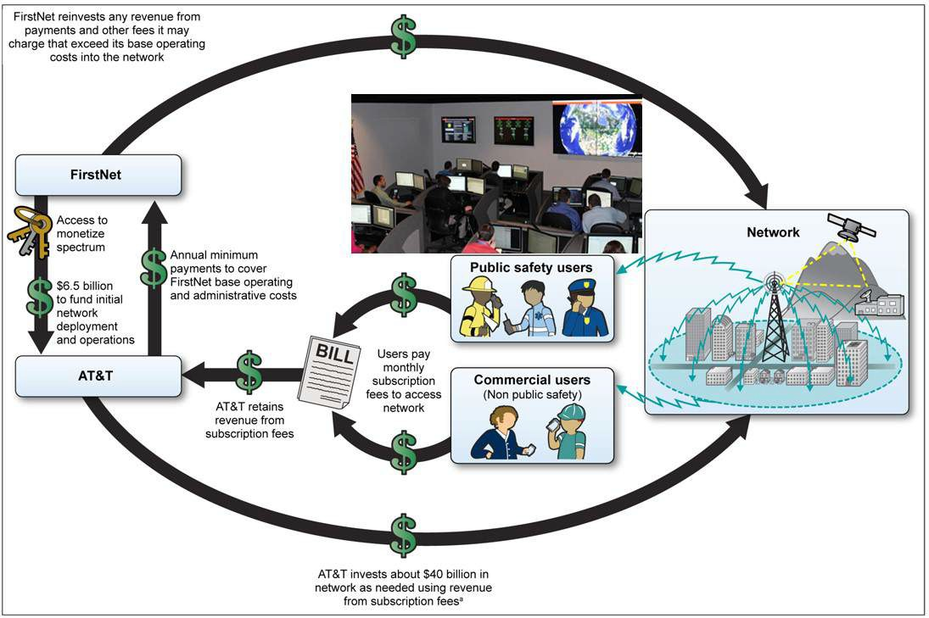
CISA adds EI-ISAC to Collaborate with FirstNet in Response to Election Threats
Security Operations Center 31 Tech Valley Drive
East Greenbush, NY, 12061
EI-ISAC- Cybersecurity
SOC
Page 19
7
https://www.gao.gov/assets/gao-17-569.pdf

Slide 11
Election Infrastructure Information Sharing and Analysis Center (EI-ISAC)
The Multi-State Information Sharing and Analysis Center (MS-ISAC) was created in 2003 by the National Association of State Chief Information Officers (NASCIO) with funding from the Department of Homeland Security (DHS).
The DHS created the Election Infrastructure Information Sharing and Analysis Center (EI-ISAC) March 7, 2018 and integrated it with the MS-ISAC.*
The Election Infrastructure Information Sharing and Analysis Center (EI-ISAC) is a collaborative partnership between the Center for Internet Security (CIS), the Cybersecurity and Infrastructure Security Agency (CISA), and the Election Infrastructure Subsector Government Coordinating Council (GCC).
It is a non-Profit organization and a division of CIS that provides election officials with a suite of cyber defense tools, including threat intelligence products, incident response and forensics, threat and vulnerability monitoring, cybersecurity awareness and training products, and tools for implementing security best practices.
* https://www.cisecurity.org/wp-content/uploads/2019/06/CIS-2018-Year-in-Review.pdf https://gcn.com/cybersecurity/2018/03/protecting-election-registration-sites-from-cyber-intrusions/298754/
8

Slide 12
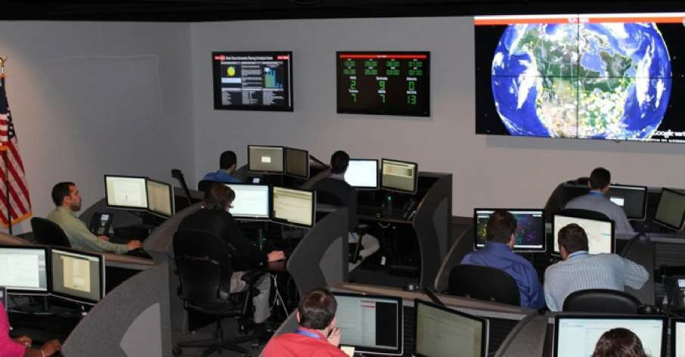

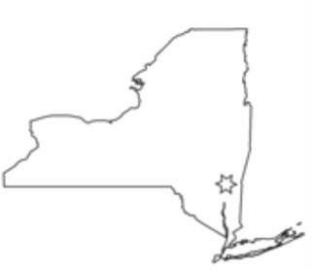

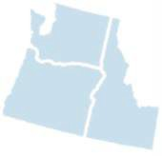
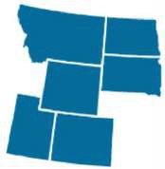
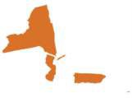
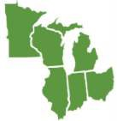

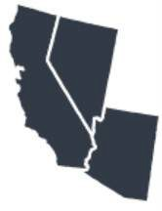
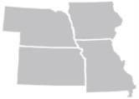
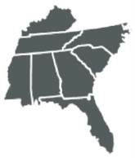
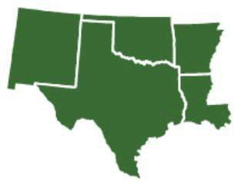
Inside the EI-ISAC / MS-ISAC Security Operations Center (SOC)
In 2018 the DHS Federalized the majority of our Municipal Elections via their Private Public Partner CIS. Their monitoring appears to be linked to our National Criminal Justice Network.
So on Election night they have a Centralized Network monitoring and likely manipulating our County vote tallies. They use the same regional structure as our FEMA services.
NEW YORK
Location of CIS
Multi-State Information Sharing and Analysis Center 31 Tech Valley Drive
East Greenbush, NY 12061 info@msisac.org soc@msisac.org
518-266-3460
9
https://www.govtech.com/blogs/lohrmann-on-cybersecurity/the-msisac-story-more-than-a-decade-of-growing-membership-and-influence.html

Slide 13
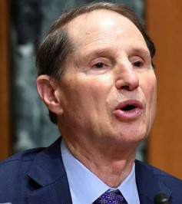
Why is Ron Wyden Putting Pizza Boxes over FirstNet’s Windows?
•
Ron Wyden 4/12/23: "My staff looked into the concerns raised by CISA and have spoken to officials at AT&T, the FirstNet Authority and the Department of Commerce’s National
Telecommunications and Information Administration (NTIA)
These officials stated that while AT&T has obtained independent audits of FirstNet, AT&T is unwilling, and the Department of Commerce is unable to share the results with CISA, NSA, other government agencies, or Congress
According to NTIA, the Department of Commerce is bound by a non-disclosure provision in the contract it negotiated with AT&T. As a result, NTIA told my staff, NTIA and the FirstNet Authority are not allowed to reveal how frequently AT&T commissions these audits, how robust they are, what the audit results were, or whether all vulnerabilities discovered during the audits have been fixed."
10
https://www.reuters.com/world/us/us-cyber-watchdog-has-no-confidence-security-us-emergency-cell-network-senator-2023-04-12/

Slide 14
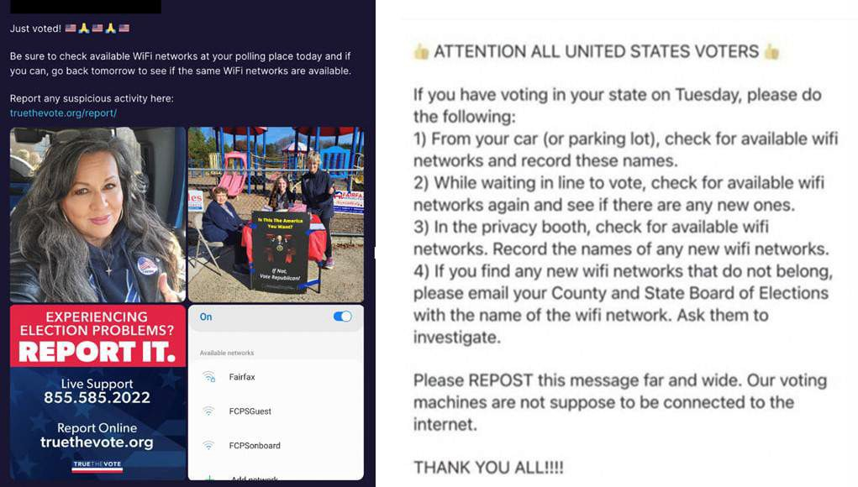
Message to Check WiFi’s in October 2022
https://twitter.com/EI_Partnership/status/1592689698388217858
11/15/2022
11

Slide 15
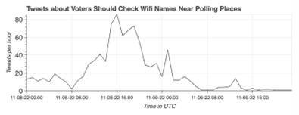
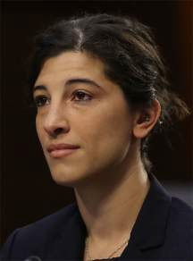
DiResta fed CIA’s Scorecard during Midterms
Why was ex-CIA employee Renée DiResta so concerned about voters watching Wi-Fi Names?
“In the lead up to Election Day, we (the EIP) monitored calls for voters in states across the U.S. to document WiFi connections, with claims that internet networks at polling locations were evidence of
election interference.” https://twitter.com/EI_Partnership/status/1592689698388217858
11/15/2022
One has to wonder why the EIP would monitor a narrative like this ("Pollbooks connecting to the Internet via WiFi") so closely if they REALLY thought was it was disinformation. Wouldn't they just ignore it if it wasn't true?
12

Slide 16
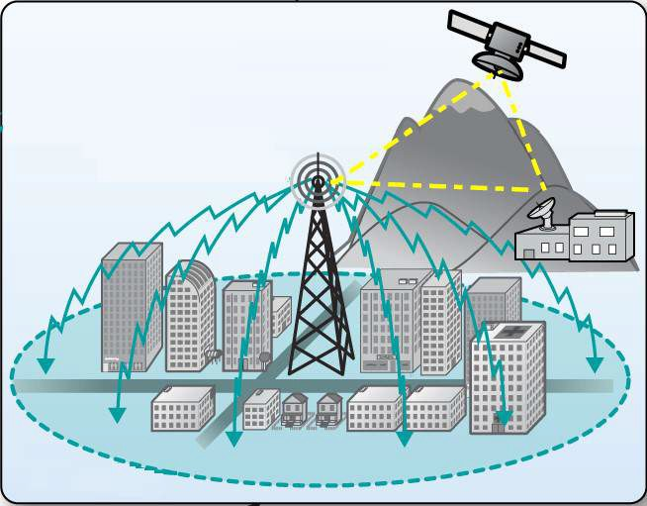

AT&T FirstNet Public Safety Network Concept
How do you build it?
Answer: You make it look just like LTE (Cellular)
SatColt
Teleport
13
https://www.cisa.gov/sites/default/files/publications/NSTAC%20STF%20Report%20FINAL%2011302009_0.pdf

Slide 17
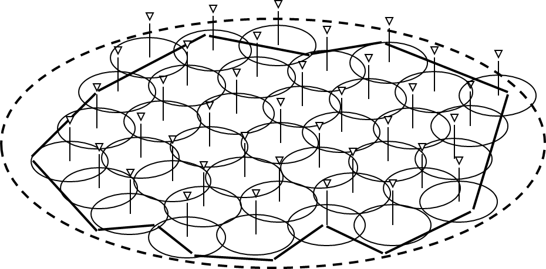
AT&T FirstNet Public Safety Network
There are many technical difficulties with making a single Boomer LMR- type Network
The most practical and stealthiest solution is to “Clone” the LTE Network (Band 14)
The Cellular Concept, V.H. MacDonald, AT&T Bell Labs, 1979,
https://worldradiohistory.com/Archive-Bell-System-Technical-Journal/70s/Bell-System-Technical-Journal-1979-1.pdf
14

Slide 18
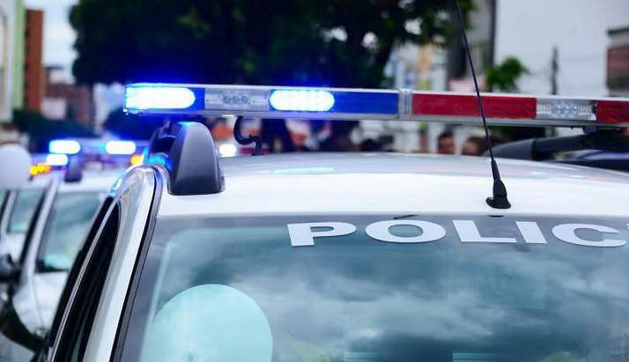
FirstNet: All AT&T LTE bands to be available to public safety before 2018
“These features will become available over existing AT&T LTE bands nationwide while FirstNet deploys Band 14 for public safety. This will dramatically increase the capacity available to public safety without having to wait for the availability of Band 14. It will provide first responders with unprecedented access to the Network when the need arises without impact or competition from commercial customers.”
That is, AT&T/FirstNet doesn't specifically need Band 14 to rig elections.
AT&T/FirstNet: "Trump we're coming after you"
15
https://www.fiercewireless.com/wireless/firstnet-all-at-t-lte-bands-to-be-available-to-public-safety-year

Slide 19
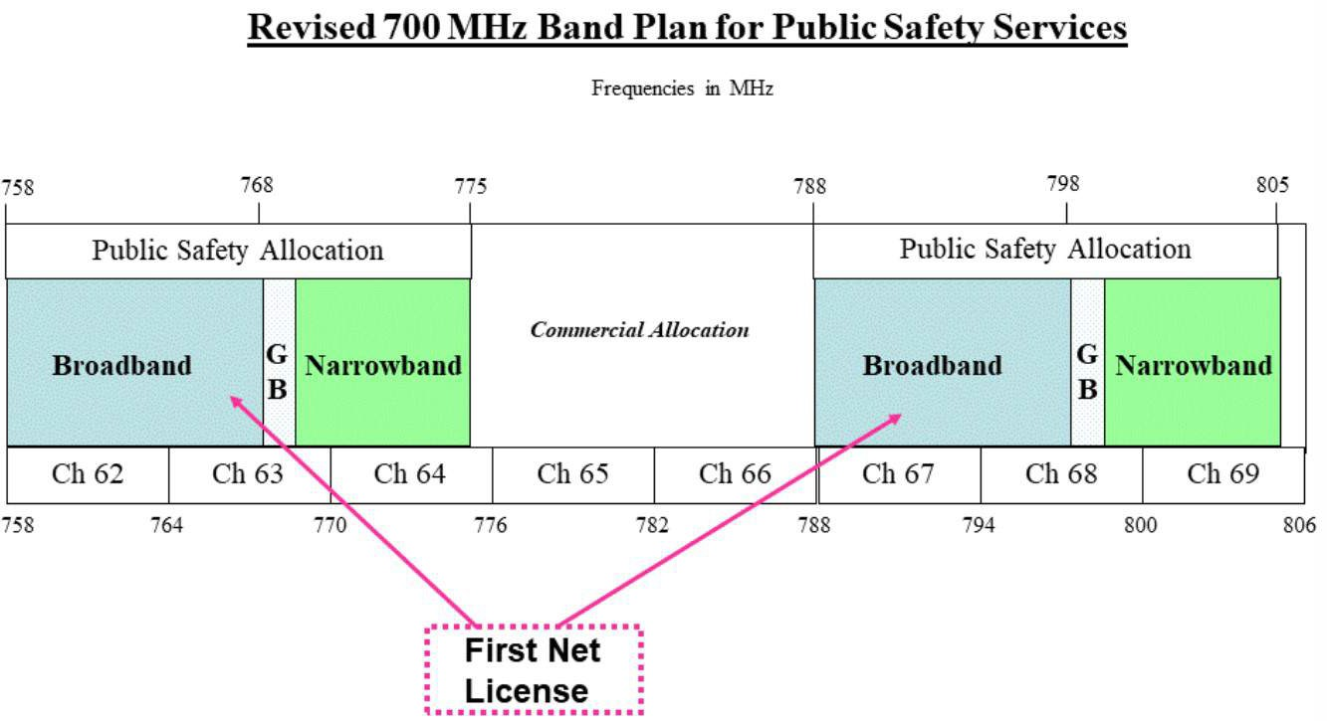
AT&T/FirstNet’s Band 14 Plan
Base Transmit (Downlink)
Mobile Transmit (Uplink)
Band 14 will remain 4G for years
Broadband Segment (758-768/788-798 MHz)
https://www.fcc.gov/700-mhz-public-safety-narrowband-spectrum
16

Slide 20
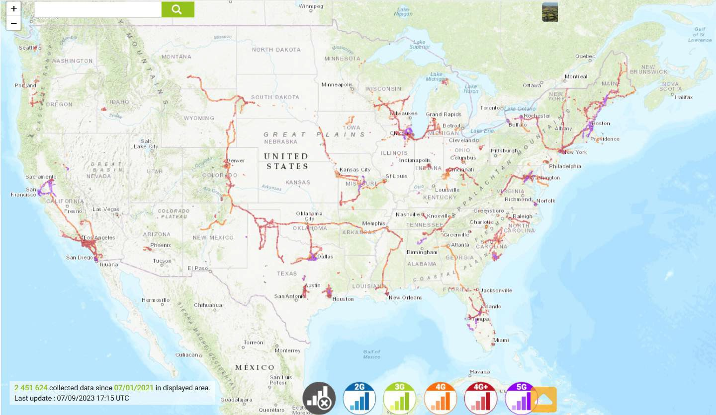
AT&T/FirstNet’s Band 14 US Coverage
17
https://www.nperf.com/en/map/US/-/187448.ATT-FirstNet/signal/?ll=32.47269502206151&lg=-103.35937500000001&zoom=4

Slide 21
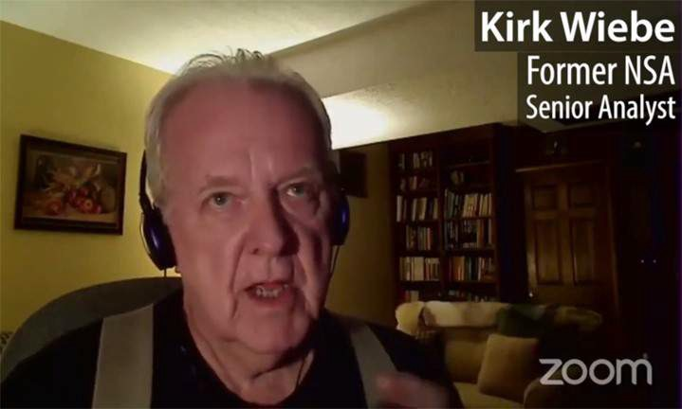
HAMR’s Network has Real-Time, Zero Delay Access to ALL Precincts
Former NSA senior analyst J. Kirk Wiebe: "HAMR (and Scorecard) ... is designed to change votes on the fly. As they are reported ...by locations in all Precincts and Counties... as totals are reported via the Internet, the data is grabbed in real time, changed, ... and this happens in microseconds.... the data is changed so quickly in the favor of (the preferred Candidate) that no one notices a delay and just accepts the total. This has been going on in numerous States, including Battleground States..." https://rumble.com/v2ud204-nsa-whistle-blower-describes- hammer-and-scorecard.html
See also Sidney Powell on Lou Dobb’s 11/13/20: https://nikipress.com/2020/11/14/sidney-powell-on-lou-dobbs-11-13-20/
18

Slide 22
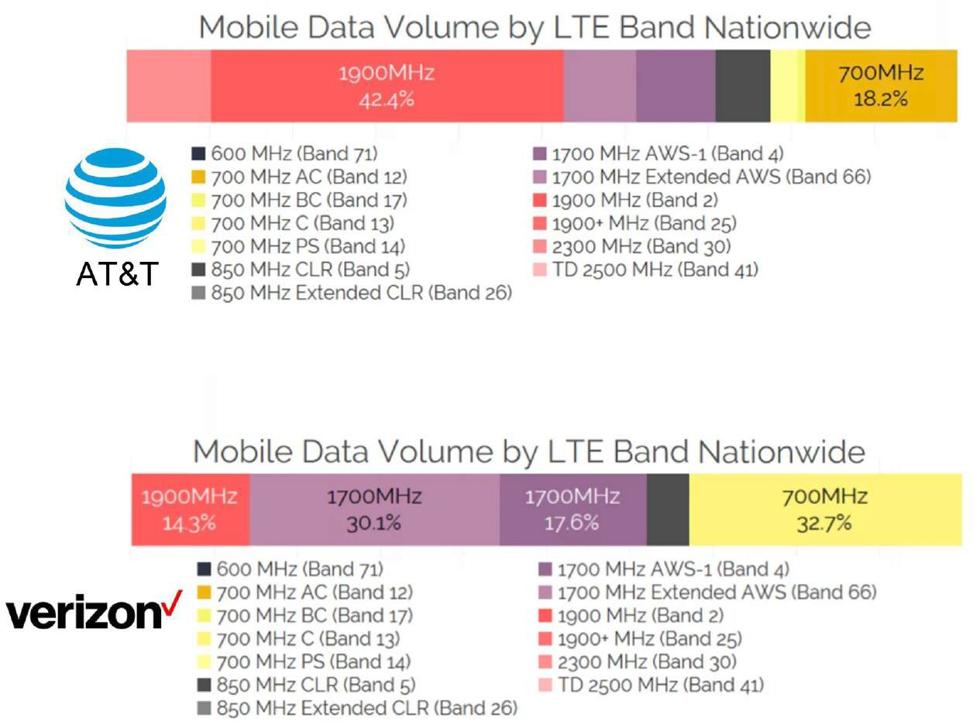
4G LTE Spectrum Available to Public Safety
Band 14 ~1.5%
Carrier | 4G LTE Bands | Main Frequencies
AT&T | 2,4,5,12,14,17,29,30,66 | 1900, 1700 abcde, 700bc
Verizon | 2,4,5,13,46,48,66 | 1900, 1700 f, 700 c
19
https://www.phonearena.com/news/Cheat-sheet-which-4G-LTE-bands-do-AT-T-Verizon-T-Mobile-and-Sprint-use-in-the-USA_id77933

Slide 23
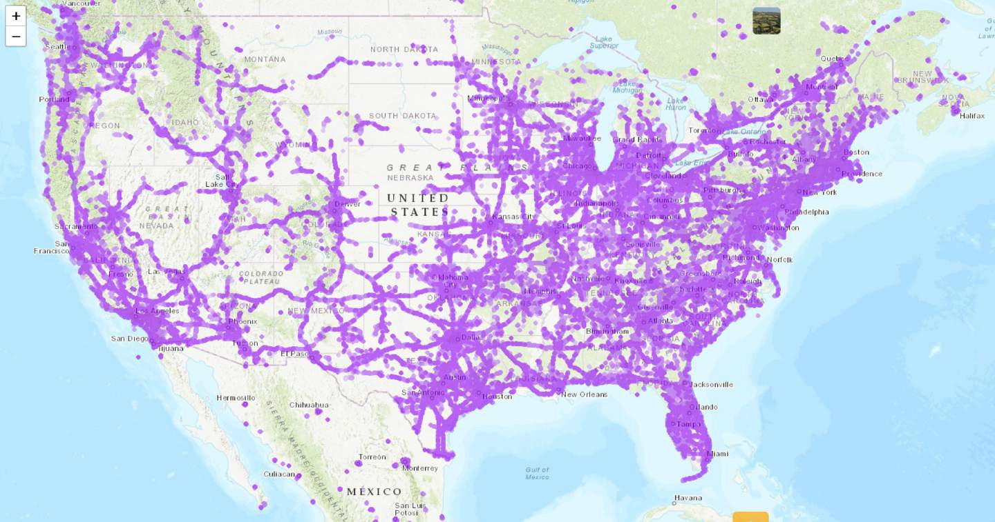
First Responders Preemptive US Coverage (5G)
https://www.nperf.com/en/map/5g
20

Slide 24
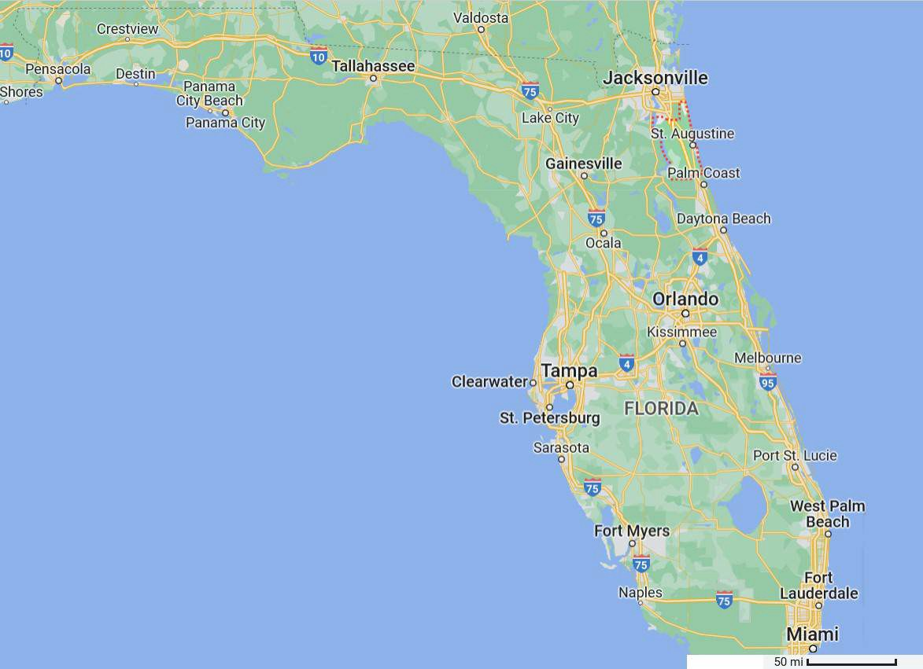
St. Johns County
Florida
St. Johns County Florida
21

Slide 25
Was the 5G Public Safety Network used to Monitor Florida Voter Precinct Data?
Recent events during the 2022 Florida Midterms* likely explained by First Responder monitoring, and perhaps manipulating, the Precinct Election vote data in St. Johns County
This is not absolute proof
But, given everything else we know about Election Fraud, it is some very good
*repo_{c}rt_{i}f_{r}r_{c}om_{u}J_{m}oan_{s}n_{t}e_{a}: _{n}htt_{t}p_{i}s_{a}://_{l}t.m_{e}e_{v}/W_{id}eT_{e}he_{n}P_{c}eo_{e}ple_{t}P_{h}ra_{a}yF_{t}o_{t}rG_{h}o_{e}dsK₅in_{G}gdo_{P}mU_{u}S_{b}A/_{l}5_{i}7_{c}58
22

Slide 26
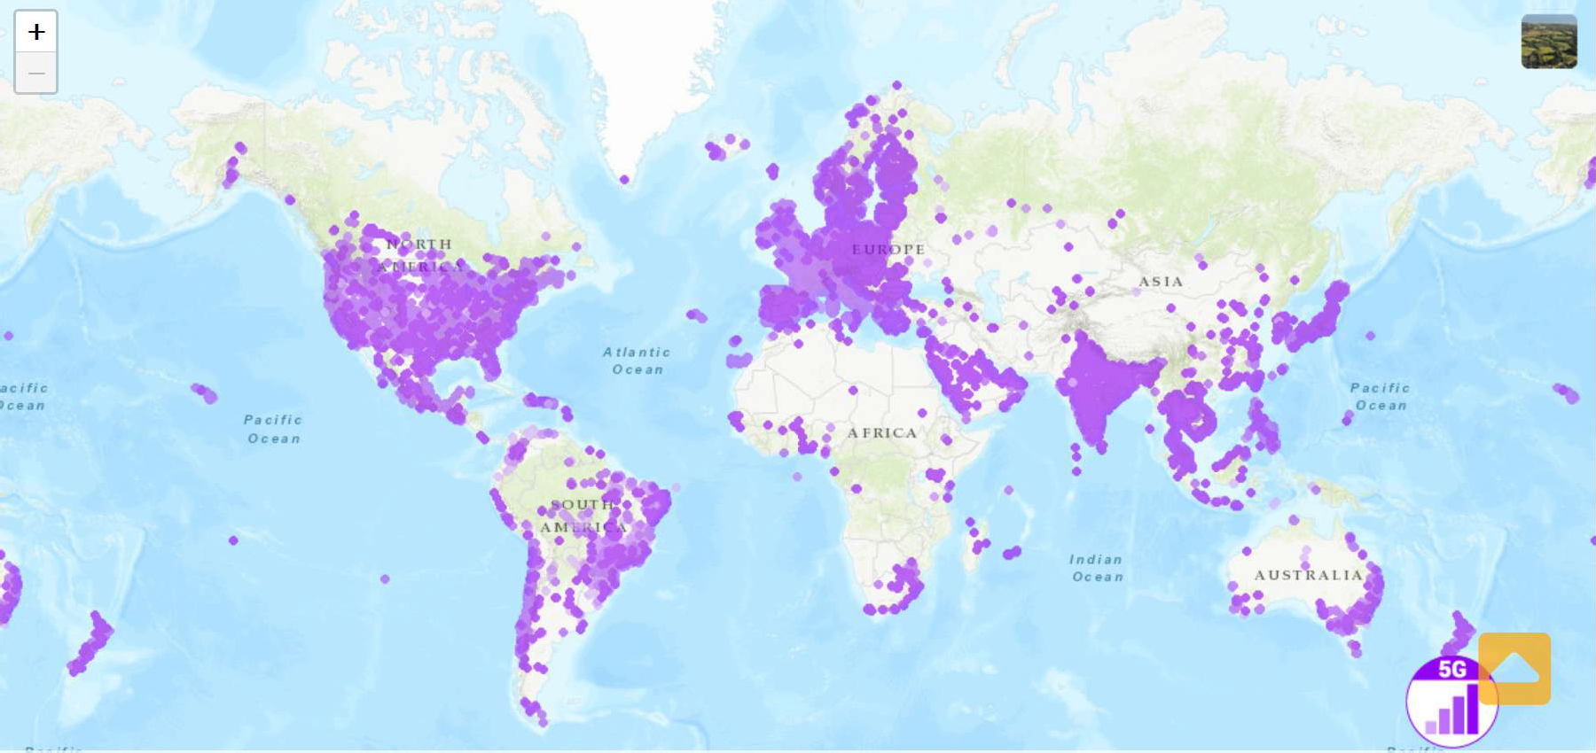
5G Worldwide Coverage Map
One (or more) of the following conditions is true:
region had Election Fraud in the last 10 years
region used Electronic Voting Machines
Did a High Level Democrat (Biden, Stacey Abrams...) travel there within the last 10 years there to promote Election Integrity
region run by a member of the WEF
https://www.nperf.com/en/map/5g
As AT&T is building out Band 14 nationwide, the wireless carrier simultaneously is upgrading its network infrastructure to equipment that can support 5G services on spectrum
FirstNet users investing in 5G devices will be able to take advantage of this upgrade on AT&T’s commercial spectrum, but the 20 MHz of 700 MHz Band 14 airwaves licensed to the FirstNet Authority will remain on 4G LTE for years. 5G phones are backward compatible with Band 14.
https://urgentcomm.com/2019/09/11/firstnet-users-will-have-access-to-5g-but-band-14-will-remain-on-4g-lte-for-years-atts-firstnet-lead-says/
23

Slide 27
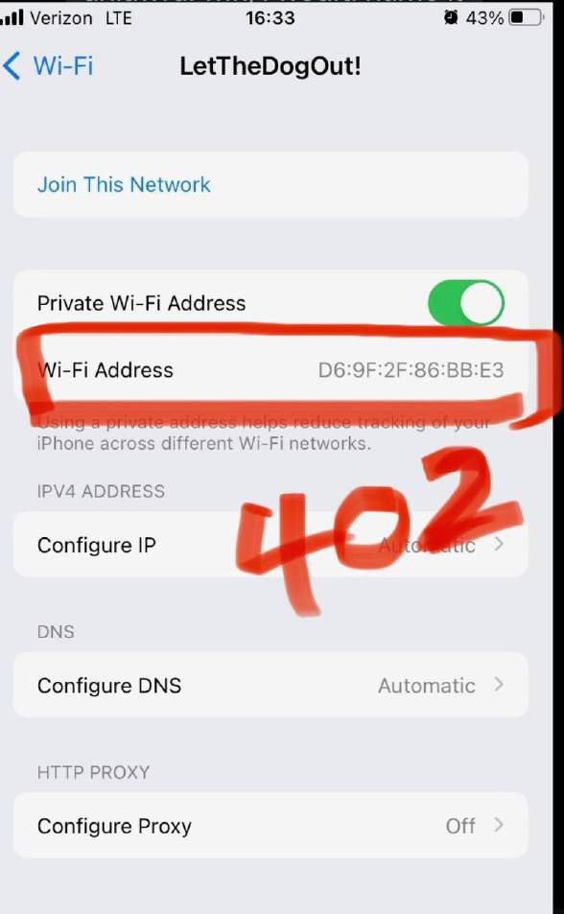
Countywide Wi-Fi “LetTheDogOut!”
St. Johns County, FL voters noticed that 15 of their Precincts, which were geographically equally distributed across the entire County, had a Private Wi-Fi named LetTheDogOut!
One Example: Precinct 402
Our Lady Star of the Sea Church, 545 A1A North,
Ponte Vedra Beach, FL 32082
“Wi-Fi MAC address is not a standard one but one that was revised by an admin or could be a randomized MAC. Media Access Control (MAC) address randomization is a privacy technique whereby mobile devices rotate through random hardware addresses in order to prevent observers from singling out their traffic or physical location from other nearby devices. So appears to be something centrally managed or someone who knows to hide their device info (some android devices have it available for it for privacy so it
could still be a phone)” -Truegrits 11/9/22
24
https://t.me/WeThePeoplePrayForGodsKingdomUSA/5746?comment=3838

Slide 28
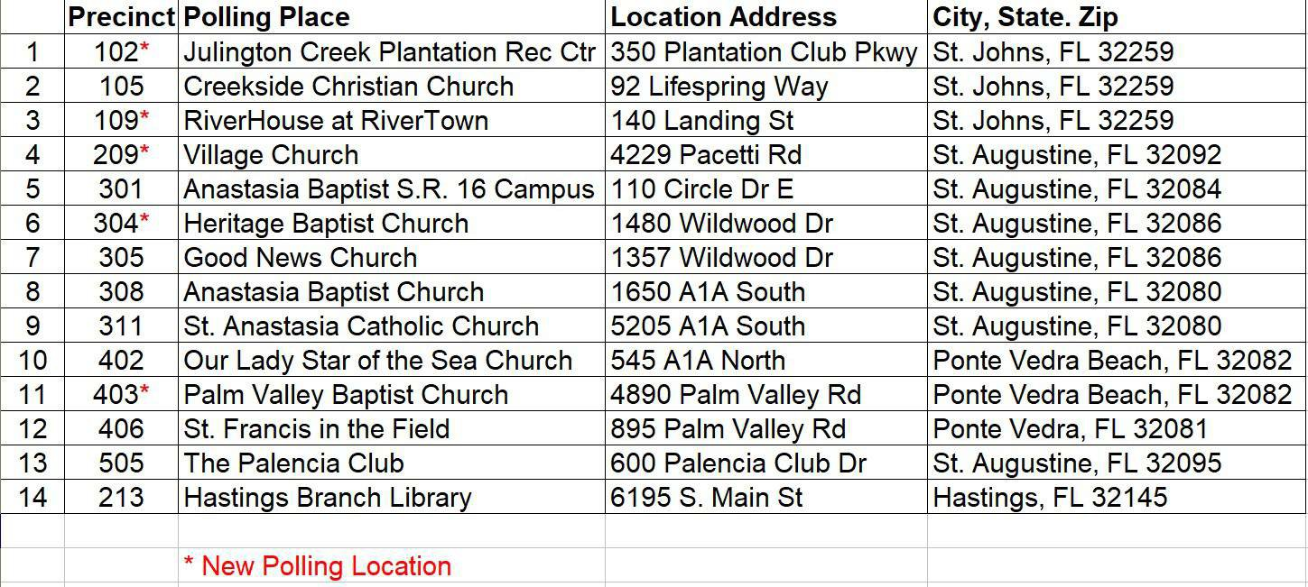
Location of 14 Different 2022 Precincts in St. Johns County, FL with WiFi Names “LetTheDogOut!”
For the reasons previously stated, we will use 5G preemptive coverage as an indicator of the First Responder, Public Safety Coverage. FirstNet’s Public Safety System’s Band 14 will remain 4G for years. 5G Phones are backward compatible with 4G.
https://t.me/WeThePeoplePrayForGodsKingdomUSA/5746?comment=3838 25

Slide 29
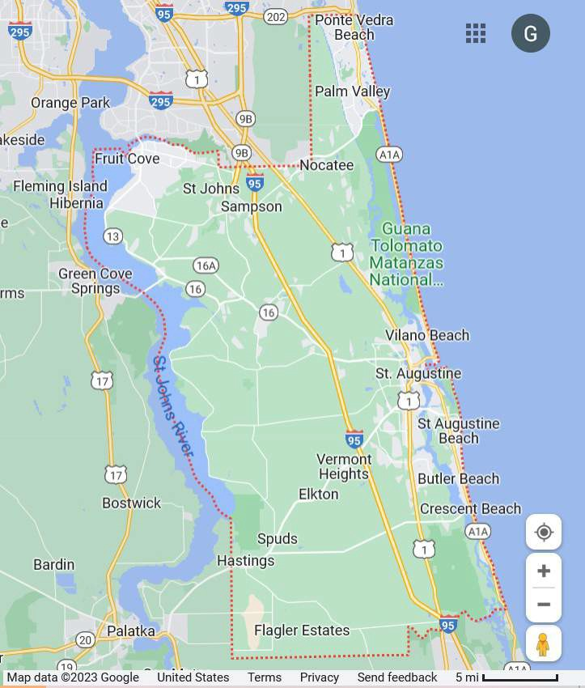
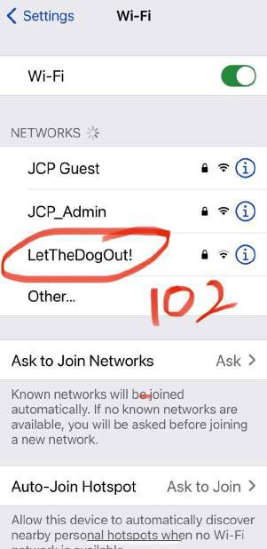

Location of 14 Different Precincts in St. Johns County, FL (for 2022) with WiFi Names “LetTheDogOut!”
10
11
They were spread out over the Entire County
1
2
12
3
13
The Precincts are the endpoints of what appears to be a County- Wide WAN
4
5
8
Example: Precinct 102
1
6
7
9
14
26

Slide 30
10
11
5G Coverage in St. Johns
-The Critical Infrastructure status of 5G allows Bad, anonymous, actors to reach the Precincts with complete invisibility
1
2
12
3
13
-Precincts with WiFi Connections named “LetTheDogOut!” covered the entire County
4
5
-The Precincts align well with
5G’s (e.g. AT&T/FirstNet) Coverage
8
6
7
-Only Precinct is not directly
9
3
Covered by 5G but since it is a new Precinct, perhaps 5G hasn’t updated their Coverage Map at that location yet
14
5G Coverage https://www.nperf.com/en/map/5g
27

Slide 31
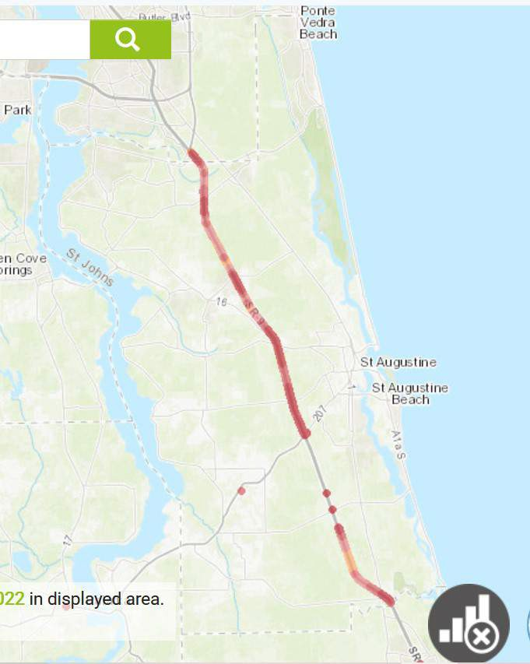

-FirstNet Band 14 Coverage in St Johns County
10
11
-Notice none of the Precincts shown here have Band 14 Coverage
1
2
12
-That means First Responder 5G Companies are likely preempting Commercial LTE coverage on Election Night at these Precincts as a Public “Safety” service
3
13
4
5
-But what is the Emergency that They are Protecting us from?
8
6
7
9
14
https://www.nperf.com/en/map/US/-/187448.ATT-FirstNet/signal/?ll=29.906138955802703&lg=-81.27410888671876&zoom=10
28

Slide 32
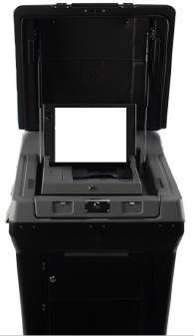

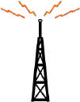
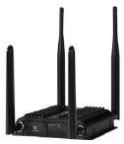
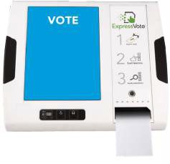
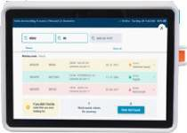
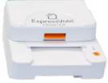
Dallas County 468 “Pop-Up”
Vote Centers 2020
DS200
*
Voter Credential Check
Internet
Tabulator
Verizon
**
Private APN
IBR600C
Router & Firewall
NetCloud
ES&S BMD
redundant
Dallas County Election Center
Private APN
*Although the DS200 has a Cellular Modem Option, the tally is
usually recorded on a memory stick which is read at the County
** Prioritized Verizon LTE IP Data Link
@21:00 https://www.brighttalk.com/webcast/11689/410268
ES&S
Pollbook
ES&S
Printer
29
1. Pollpads were caught adding hundreds of voters

Slide 33
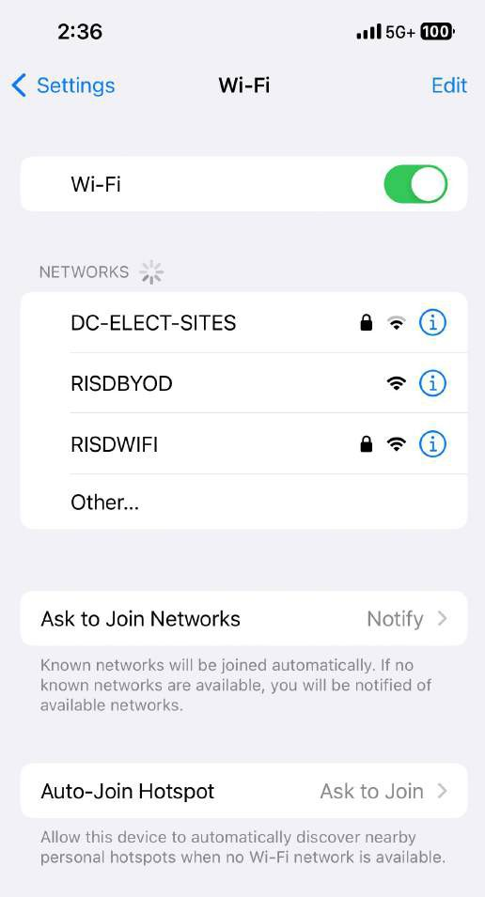
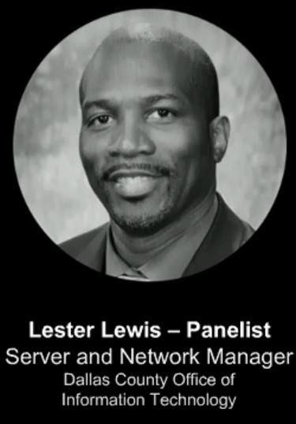
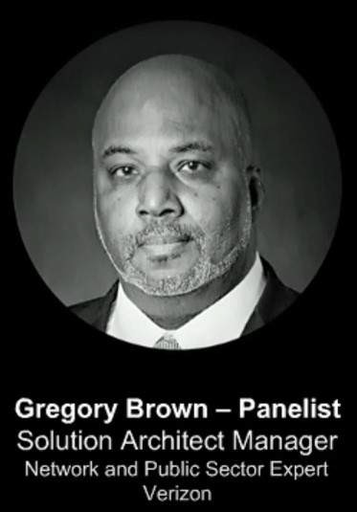
Dallas County Vote Center Wi-Fi
@10:53 Lester Lewis: “Because we were able to use remote tools,… to look and to see the signal strength from the carriers… if we have a (signal strength) issue …I was able to define the issue right then
Private
(remotely from the County Center), call Verizon and they were able to make some changes there…
and we were able… to make that happen on Election Night within an hour”
@27:08 Gregory Brown: “Dallas County upgraded their modems (to Cradlepoint) so that they could have that real- time voter count and voting results sent back to the data centers”
https://www.brighttalk.com/webcast/11689/410268
30

Slide 34


Government Control Of Vote Tabulation
Foreign Malign Influence Center FMIC/ODNI
DHS
FirstNet
EI-ISAC
AT&T
INTERNET
AZURE / AWS / GOOGLE
Band 14
Primary Fusion Center
CIS
DMV
ERIC
LTE
Wi-Fi
AT&T / Verizon / T-Mobile
Precinct
SOS
Server
 |  | Voter
Albert Sensor
 |  | Registration
County Election Center
AIR GAP
Tabulator
USB
Database
e-Pollbooks
USB
Tabulator
Tabulator
Printer
To DPS
STATE OFFICE
WebEOC Portal
31

Slide 35
Creating the Government’s Backdoor into our Voting Precincts
It appears that LTE Public Safety carriers, via preemption, are the most likely method for Bad Actors reaching the Precincts. However, some cases may use the licensed Public Safety Band (Band 14) of AT&T/FirstNet. Confirmation of this is difficult because of the critical infrastructure status and the non-disclosure agreement FirstNet has with the DOC (i.e. the Cybersecurity Information ‘Sharing’ Act, (CISA) 2015).
The environment for the Government’s intrusion is partially determined by the IT people when they configure the router at the Vote Center or the Precinct for a Private Wi-Fi Network. The IT manager sets up the Private Network with Wi-Fi Protected Access 2 (WPA2) and a Firewall. The router can also be set to randomize the MAC Address to keep the network from being identified. The randomization can be shared if necessary with "trusted people". The router provides a secure (i.e. private) two-way connection between the Local Election Equipment (Tabulator, BMD, e-Pollbook) to the LTE (e.g. 5G or Band 14) Network.
With this two-way connection established, the LTE Network (e.g. FirstNet) can monitor the real-time vote counts so they can compute the number of fraudulent Mail-In ballots that they need. The Precinct (and County) results can be remotely changed by a Man-In-The-Middle operating on the LTE Network. The election results can be entirely fabricated with this clandestine configuration and nobody would know.
32

Slide 36
Justifying Government Control of Elections
A HOW TO PROCEDURE:
You create a complex web of Government agencies, Councils and Private Sector Companies, NGOs: EI- ISAC, FirstNet Authority, CISA*, CIS*, EISCC*, DHS, Telecoms (AT&T, Verizon,..), Police Agencies….
You institutionalize the sharing of Election Information over the Internet by placing that in the Public Charters of those Agencies*
You get the media and their Censorship allies to gaslight the Public that your Ornamental Elections are not connected to the Internet
You constantly promote fear of impending Election Doom cementing Elections as an Emergency Issue in the Public’s view, requiring First Responder intervention
Your Public Safety predicate becomes a self-fulfilling prophecy when the Public finally figures out that the Government has complete control of their Elections
33

Slide 37
FirstNet Timeline
2000 Center For Internet Security (CIS) Private Corporation created by DHS 2001 9/11 -Twin Towers & Patriot Act
2002 HAVA -11 States w online Voter Registration Data Base (VRDB)
2003 Multi-State Information Sharing and Analysis Center (MS-ISAC) joins CIS 2004 Bush-Kerry Ohio Diebold Election Fraud
Laptops widely available with Wi-Fi 802.11g 2008 0bama's First Term
2009 Feb 3 - 0bama moves HAMR from CIA to Fort Montgomery & Begins Domestic Surveillance
2010 3G LTE Complete 2012 0bama's Second Term
Maxine Waters: "0bama has an organization/database that no one has ever seen before"
First Responder Network Authority (FRNA of Department of Commerce)
Oct 1 - Electronic Registration Information Center (ERIC), CO, DE, MD, NV, UT, VA, WA were 1st Members
2014 EuroMaidan - Ukraine: Removal of Yanukovch, Installation of Poroshenko
2015 CISA - Cybersecurity Information Sharing Act (Avoid Disclosure), "Freedom" Act 2016 Trump 1st Term
90% of Precincts used Laptops (with Wi-Fi) to connect to VRDB
Russian Collusion/Hacking --> Oct 7- State of Public Safety Emergency --> Spy on Trump Campaign & Family with HAMR 2017 January -Elections were made Critical Infrastructure
FirstNet (March 31) Public Safety Public-Private Corp with FRNA and AT&T, can Preempt Commercial LTE traffic
Oct 16 - The FCC authorizes the government to use the commercial LTE band for first responders
2018 Election Infrastucture Information Sharing Center (EI-ISAC) (March 7) merges with MS-ISAC and also working for CIS
March 27, Precursor of Verizon Frontline, Public Safety System Launches can Preempt Commercial LTE traffic
Midterms (Nov 6) R's lose 40 House seats to D's
Nov 16 - Cybersecurity and Infrastructure Security Agency (CISA) created by DHS
2019 Oct 18 - Event 201
Dec 1 - Wuhan Outbreak
2020 Jan 9 - WHO makes Covid Announcement March 20 - Fauci: "2 weeks to flatten the curve"
Nov 4th Insurrection, Biden Installed, 33 States had Mail-In Ballot Programs
Dec 25 - AT&T Nashville Data Center Bombing
Jan 6th Freedom Rally
34

Slide 38
References
Poll Pads Caught Adding *Hundreds* of Voters in Real Time as Poll is Being Closed, by Brian Lupo Nov. 12, 2022 https://www.thegatewaypundit.com/2022/11/breaking-exclusive-election- poll-pads-caught-adding-hundreds-voters-real-time-texas-poll-closed-video/
General Tunneling
https://www.cisco.com/c/en/us/td/docs/wireless/asr_5000/21-15_6-9/SAEGW-Admin/21-15-SAEGW-Admin/directtunnel4g.html
Verizon’s Zero Tunnel
https://opendevelopment.verizonwireless.com/content/dam/opendevelopment/pdf/VzServices/PN_RR_CustomerGuidelines_Apr2017
.pdf
CradlePoint’s Netcloud https://cradlepoint.com/products/netcloud-service/
The Secret History of the Shadow Campaign That Saved the 2020 Election https://time.com/5936036/secret-2020-election-campaign/
“The Air-Gap Myth” – KanekoaTheGreat https://twitter.com/KanekoaTheGreat/status/1648462770936115202
Enabling intelligent operations with Mission Critical Networks, Ericsson,
https://www.ericsson.com/494930/assets/local/mission-critical-comm/doc/ericsson-mission-critical-networks.pdf
"The Federalization of US Elections"- Charles Bernardin, 2/23/23 https://rumble.com/v2ba4aw-how-deep-is-dhs-in-our-county-elections.html
General McInerney describing HAMR, 11/14/20 https://www.youtube.com/watch?v=U7KkcLKBxFY
35

Slide 39
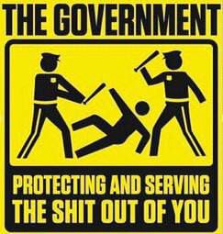
The whole point is our Government used the facade of an innocuous first responder network to put things in place to steal our elections and set up a One-World Surveillance system to protect and serve the shit out of us.
36

